Slide 1
Data quality app – a hidden gem
Data Quality Academy On line

Slide 2
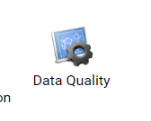
DQ app and some questions
Have you seen this app?
Have you used this app?
Do ALL analytic users have access to this app?

Slide 3
Data Quality App - Learning Objectives
Most common use of DQ App
The value of validation rules
How to translate VR into actual use
Issues associated with DQ App

Slide 4
DHIS2 DQ App
Contains the following
Validation rule Analysis
Standard deviation Analysis
Min-Max outlier Analysis
Follow-up analysis

Slide 5
Validation rules
Who is responsible ?
They are not important - so it does not matter
Nobody runs them any way, and if they run them, no one does anything anyway

Slide 6
Validation rules
Who is responsible for thinking about them and then defining them
HMIS DHIS2 configuration expert
Program manager
District Information Officer
Who is responsible for running them
Data Entry clerk
Program manager
FIO/DIO or higher level

Slide 7
Understanding the Logic of Validation Rules
A method to assess the quality of data entered in DHIS2
Based on a set of predefined rules set for the data
This does NOT allow you to FULLY assess whether or not reported numbers are completely accurate

Slide 8
Validation rules – how to define
An expression that defines a relationship between a number of data elements
Expression has Left side, Right side and an Operator
Common operators used
less than <=
equal to ==
greater than >=
Validation Rules are created based on what you know to be true e.g.
‘Malaria RDT tested’ CANNOT be more than ‘Malaria RDT positive’
For instructions on how to set up a validation rule – look at the DHIS2 manual

Slide 9
Validation rules
Some simple guides to VR
Validation rules are assigned to groups
Easy to use and understand
Signs like <= or == or >= - does everybody understand them
Use of Importance field (Low/Medium/High)
Consistent guide to setup, i.e. always have smaller number first
These SHOULD be run after data entry before the Complete button is ticked
Validation rules should be run after most/all monthly data has been captured
Who is responsible for this (F/DIO, Program manager?)
Is there an SOP to guide the process of running these rules and then taking action?

Slide 10
Validation rules - and then?
How to run validation rules
Select OrgUnit
Select time period
Select Validation rule group
Click Validate
Gives a report which can be downloaded into different formats
Download into Excel

Slide 11
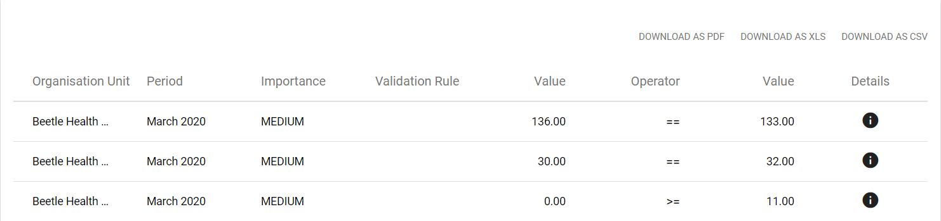
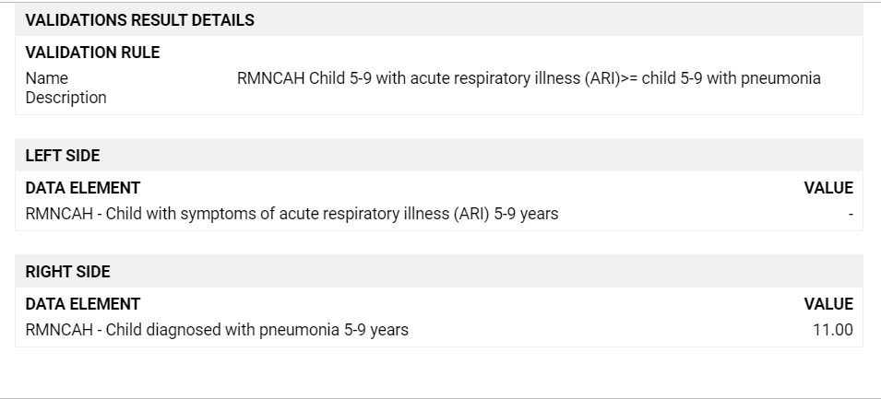
Validation rule Output
Detail icon

Slide 12
Validation rules - output
Data Quality Report
Source | Period | Validation rule | Left side description | Value | Operator | Value | Right side description
Afghan Dispensary | March 2020 | RMNCAH Women received prophylactic uterotonic immediately after birth <= facility deliveries (by age) | Received uterotonic | 67 | <= | 0 | Delivery in facility (age)
Afghan Dispensary | March 2020 | RMNCAH Contraception first time user (by age and sex) = Total Contraception first time user (by method) | Contraception first time user (by age and sex) | 18 | == | 0 | Contraception first time user by method
Alsatian Primary Health Centre | March 2020 | RMNCAH Total deliveries <= Live births + still births | Delivery in facility | 197 | <= | 196 | Sum of live births and still births
Sort according to OrgUnits
Give to supervisors/program managers for action

Slide 13
Data Quality App – the rest…
Standard deviation Analysis – now mainly WHO DQ Tool is used
Min-Max outlier Analysis – used if Min/Max values have been set
If not – set first before running Min-Max outlier analysis
See next presentation
Follow-up analysis
Used to mark data that is correct but does not fit the pattern, or triggers a validation rule

Slide 14
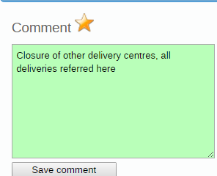
Marked for follow-up
Mark problematic data for follow up
Highlight star
SAVE - (done at Data Entry)
Useful to explain when a validation
rule has been triggered
Report can be run on Follow-up stars

Slide 15
Discussion
What are the barriers to running Validation Rules
Have most possible validation rules been set
Do validation rules pick up all the data mistakes
When obvious data entry errors are identified, why are they not corrected
Who is responsible for chasing up the data entry errors
What happens when they are not corrected

Slide 16
Exercises
Access to own country DHIS2 OR DEMO database for this training
Confirm access to Data Quality App – in MOH DHIS2
Obtain list of all Validation rules and VR Groups
Review all Validation rules
Review for consistency (smaller value first)
Run at least 2 VR Groups for last 6 months
Write a short report on rules violated
Consider an action plan
Do some rules need to be re-written to make them easier to understand
Are some rules triggered consistently
Is the problem with the data quality or the rule?
Think of 1 rule to add to the current list

